Slide 1
2.4 Binary Subtraction
50
You can do binary subtraction the way people subtract by hand.
But, especially in hardware, it’s easier to take the negation of the number (in two’s complement form) and add.
In this example, we want to subtract 63, so we find the two’s complement representation for -63 and add it. if this were unsigned:
  0100 0000 +64 64
  1100 0001 -63 193
  0000 0001 + 1 257 (overflow)

Slide 2
2.4 Binary Subtraction
50a
To subtract 63, you would add -63. If you wanted to subtract -63, you would add +63 instead.
We are using this basic mathematical fact in binary using two’s complement representation, but it is is true in any number base and representation.

Slide 3
2.4 Binary Multiplication
50b
Can do binary multiplication the way people multiply by hand.
Easy to do in hardware because the algorithm is made up of adds and shifts.
0110 Can you convert these
x 0101 numbers to decimal?
0110
0000
0110
011110

Slide 4
2.4 Mult: Booth’s Algorithm
50c
Research into finding better arithmetic algorithms has continued for over 50 years.
The methods we use by hand are not the most efficient possible.
Booth’s algorithm carries out multiplication faster and more accurately than our usual algorithm.
The general idea is to replace arithmetic operations with bit shifting to the extent possible.

Slide 5
2.4 Mult: Booth’s Algorithm
50d
Booth’s algorithm is based on this idea:
  1234 x 1001 = 1234 x (1000 + 1)
  1234 x 999 = 1234 x (1000 - 1)
Our normal way of multiplying 1234 x 999 needs large partial products. But if we could use the second equation above, multiplying by 999 would be as easy as multiplying by 1001.
In binary, this involves thinking of 1111 in the middle of a number as 10000 - 1 in the correct position.

Slide 6
2.4 Mult: Booth's Algorithm
51
⁰⁰¹¹
^{x 0110}
⁺ ⁰⁰⁰⁰
⁻ ⁰⁰¹¹
⁺ ⁰⁰⁰⁰
^{+ 0011____}
⁰⁰⁰¹⁰⁰¹⁰
In Booth’s algorithm, the first 1 in a string of 1s in the multiplier is replaced with a subtraction instead of an addition in the partial sums.
Shift the partial sums until the last 1 of the string is detected. Those partial sums will be zero.
Then add the multiplicand when the string of 1’s is over.

Slide 7
2.4 Mult: Booth’s Algorithm
⁰⁰¹¹⁰¹⁰¹
^{x 01111110}
⁺ ⁰⁰⁰⁰⁰⁰⁰⁰⁰⁰⁰⁰⁰⁰⁰⁰
⁺ ¹¹¹¹¹¹¹¹¹⁰⁰¹⁰¹¹
⁺ ⁰⁰⁰⁰⁰⁰⁰⁰⁰⁰⁰⁰⁰⁰
⁺ ⁰⁰⁰⁰⁰⁰⁰⁰⁰⁰⁰⁰⁰
⁺ ⁰⁰⁰⁰⁰⁰⁰⁰⁰⁰⁰⁰
⁺ ⁰⁰⁰⁰⁰⁰⁰⁰⁰⁰⁰
⁺ ⁰⁰⁰⁰⁰⁰⁰⁰⁰⁰
^{+ 000110101_______}
¹⁰⁰⁰¹¹⁰¹⁰⁰⁰⁰¹⁰¹¹⁰
52
Here is a larger example.
The negative partial sum is in 2’s complement.
Ignore all bits over 2n

Slide 8
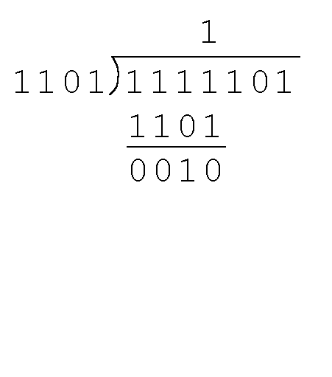
2.8 Binary Division
52a
We can do binary division the way we do it by hand.
Find the quotient and remainder when 1111101 is divided by 1101.
  We note that the dividend is divisible once by the divisor, i.e., 1111 > 1101.
  We place the divisor under the dividend and perform a subtraction.

Slide 9
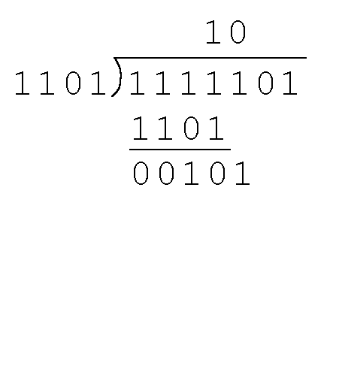
2.8 Binary Division
52b
Find the quotient and remainder when 1111101 is divided by 1101…
  Now we bring down the next bit of the dividend.
  We see that 00101 is not divisible by 1101
  (i.e., 00101 < 1101). So we place a zero in the quotient.
  Repeat until all the bits of the dividend are used.
  In fact, there are more efficient algorithms for computers.

